Slide 1
Stimulating interest in climate change ecology among first year students
David Matlaga
Notes:
Hi, I teach in the biology department here at Susquehanna and I’m going to tell you a little about how I’ve started to integrate activities related to climate change into a freshman-level course I teach.
I’d like to emphasize that these activities are works in progress and at this point aren’t fully realized.

Slide 2
Outline: Two activities
Impact of climate change on species diversity within communities
Implications of shifting species’ ranges for reserve design and management
Notes:
So I will be talking about two activities.
The first requires students to assume the role of scientist and design an experiment addressing the impact of climate change on species diversity.
The second activity is aimed at getting students to consider how we as a society can configure our natural areas and reserves to accommodate changes in species ranges.

Slide 3
The course
Ecology, Evolution & Heredity
1st course in Biology introductory sequence
Goals
Develop an understanding of the influence of climate on populations, communities and ecosystems
Gain an understanding of the scientific method as a means of generating knowledge
To gain a better understanding of the role of biology in shaping society
Notes:
Firstly, the teaching I’m going to talk about takes place in our course ‘Ecology, Evolution & Heredity’. This course is the first course in a 4 semester introductory sequence of courses for biology majors.
Therefore this course is almost exclusively freshman.
This course has several goals but with respect to what I’m going to talk about today the main content goal is for students to develop an understanding of how climate influences populations, communities and ecosystems, these being the primary levels at which we study ecology.
Also, we want students to gain a deeper understanding of the scientific method than they received in high school.
And gain a better understanding how the relationship between biology and society.
What I’m going to talk about is how I attempt to accomplish these goals using climate change research.

Slide 4
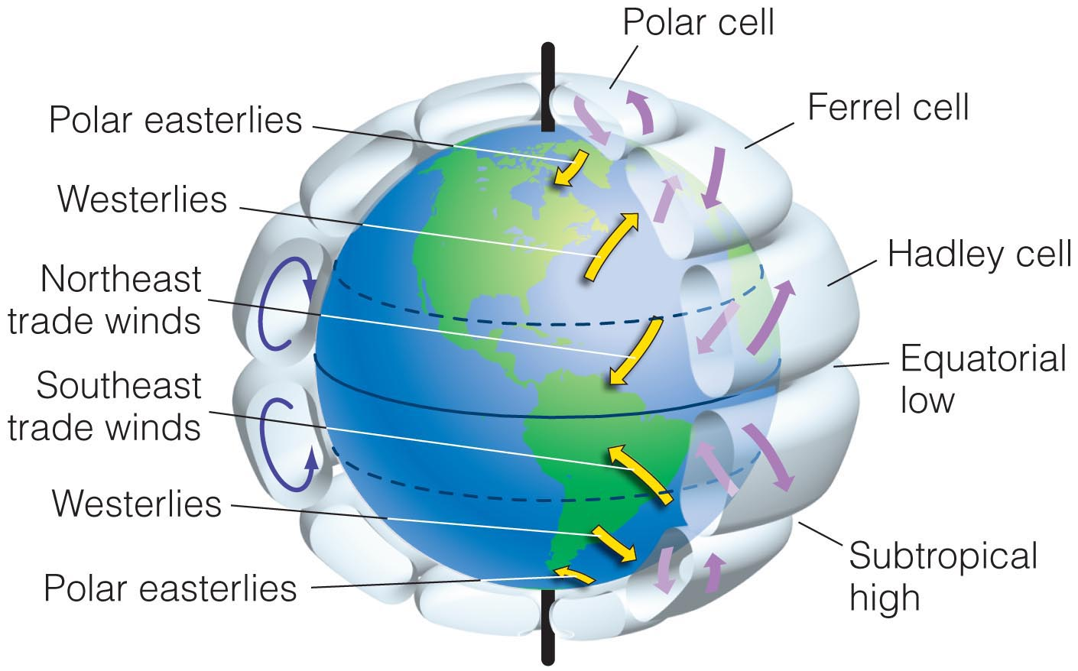
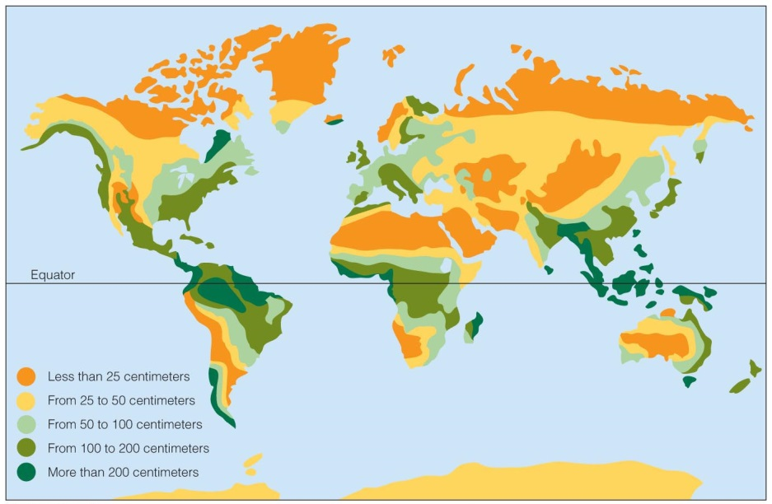
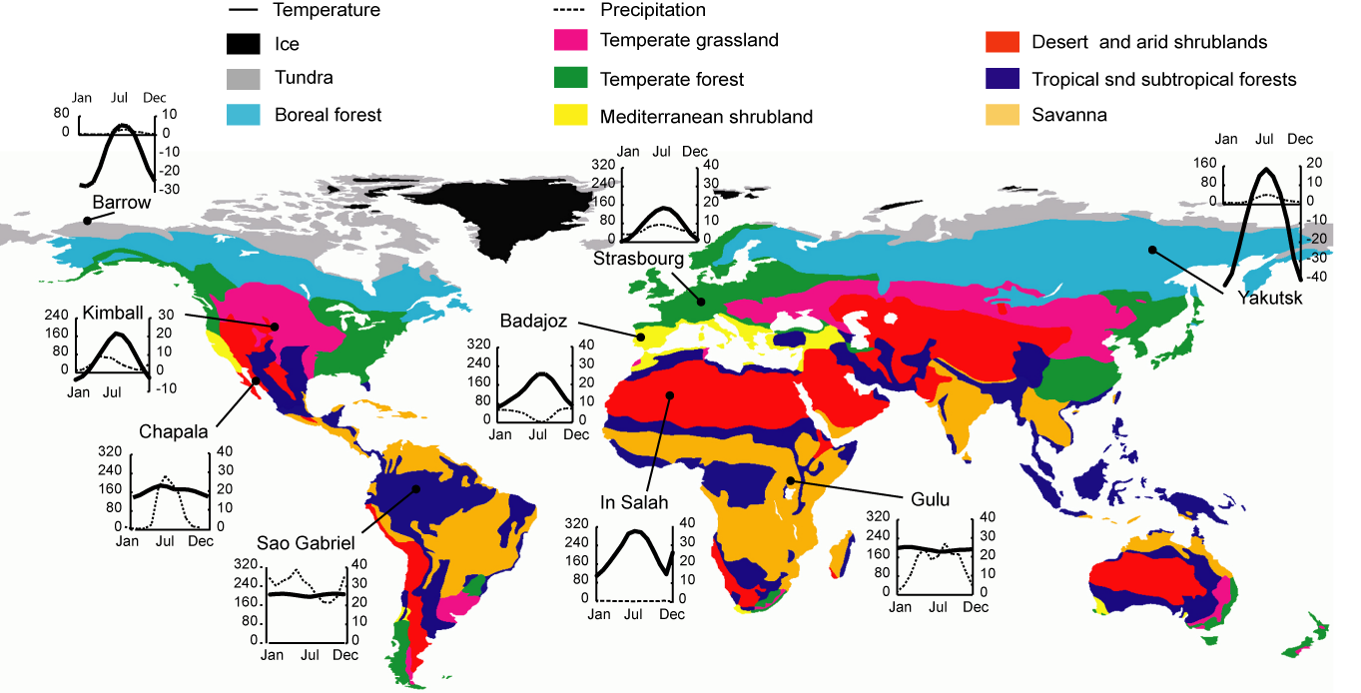
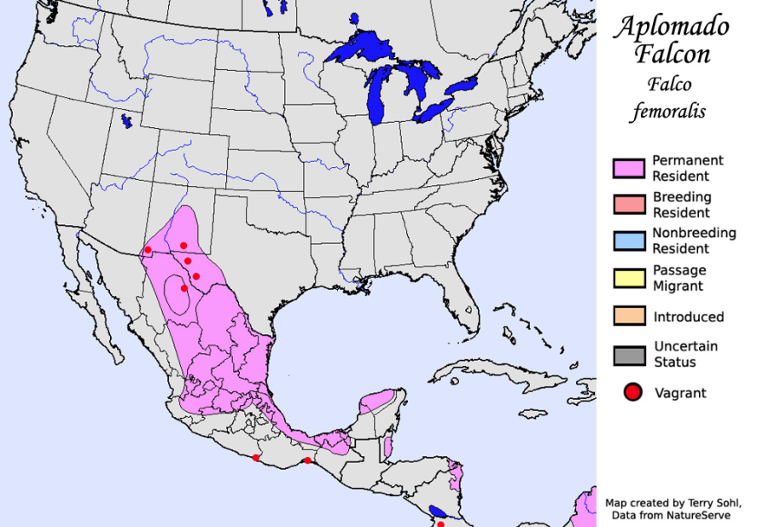
Notes:
In the first few years of teaching this course I focused on the large-scale spatial variation in climate- how global wind patterns determine the distribution of precipitation and combined with patterns of temperature these largely determine where the earth’s biomes are located.
And additionally the role of climate in determining where specific species are located.
In teaching this during these first few years I noticed two problems:
firstly I really was treating climate as a static, unchanging entity, which of course we know not to be true, and
2) secondly I felt that I wasn’t really engaging my students with this material.

Slide 5
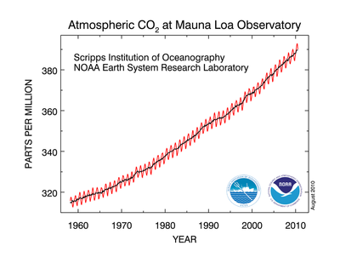
Temperature
?
?
?
?
Notes:
This year I took a different tact where I tried to present students with this fundamental question. On our planet C02 concentrations are increasing, so are temperatures. How will this influence nature?

Slide 6
How will natural systems be influenced by climate change?
Identify student’s preconceived ideas
?
?
?
?
Notes:
In taking this approach one of the first things I did was have students take 10 min and write a paragraph trying to answer this question- how will natural systems be influenced by climate change?
This question is intentionally as broad as possible, hoping that it will draw out student’s preconceived notions on this topic.
After students write individually then they report back and I summarize on the board the key points of the discussion.
In my class responses to this question were pretty dichotomous, either students thought everything is going to go extinct or climate change is going to have no effect at all. Understanding students perception of this topic first helped me understand where they were coming from.

Slide 7
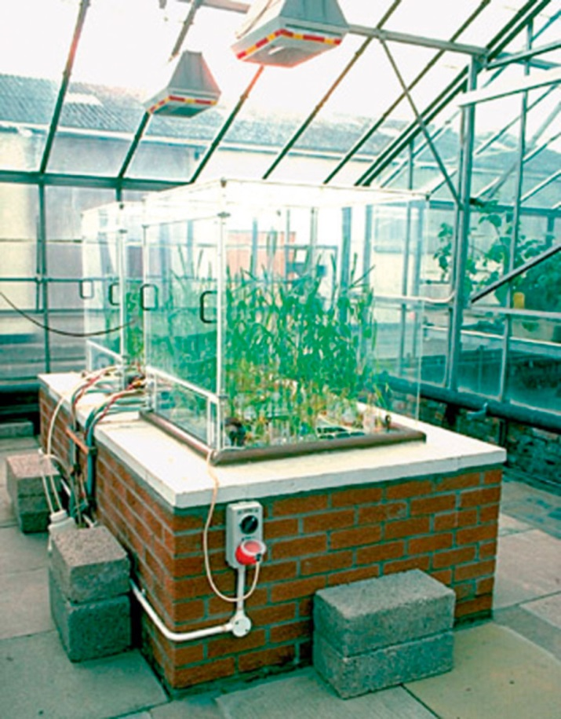
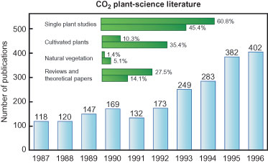
Little is known: Discoveries are still to be made!
Notes:
Then I think it is important to let students in on the secret that we as scientist really have no idea what the answer is to this question and that is because every little work has actually been done on this topic.
Here is what I mean,

Slide 8
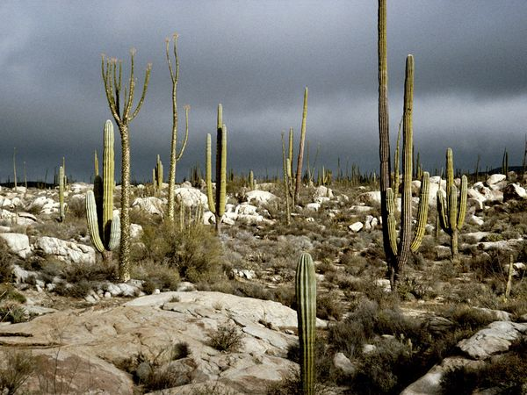
Big question: Will species diversity within communities change in response to climate change?
Climate components
CO₂
Temperature
Precipitation

Slide 9
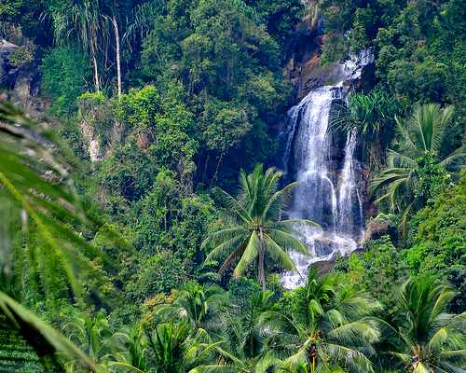
Activity
Desert
Design an experiment to determine the impact of warming on insect diversity
Peer review- Identify 2 potential confounding variables and suggest methods to eliminate these
Rainforest

Slide 10
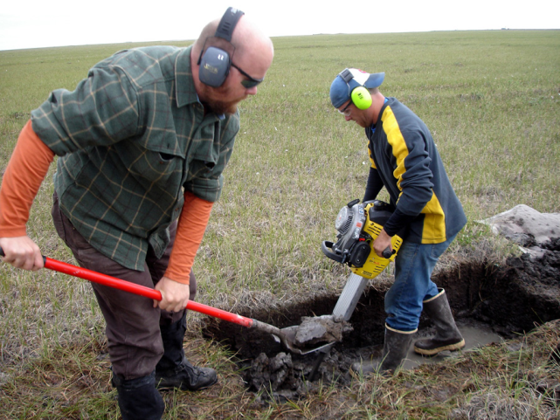
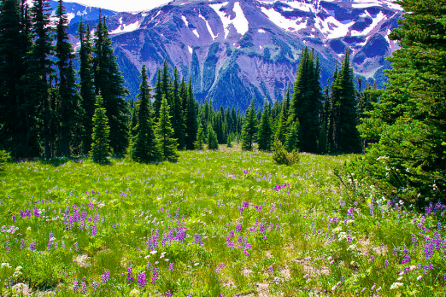
Difficulties inherent to ecological research
Correlational study
Manipulative experiment
Vs.
Perfect Mimic nature? Not so perfect
No ID cause/effect? Good-to-fair
No Confounding var.? Yes

Slide 11
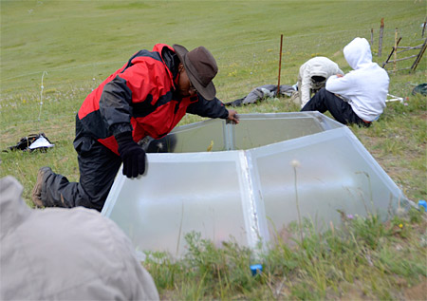
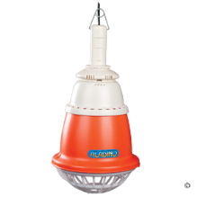
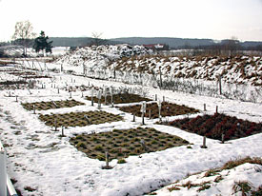
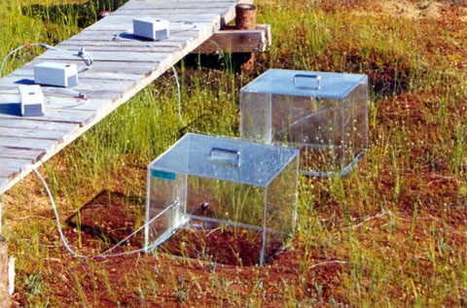
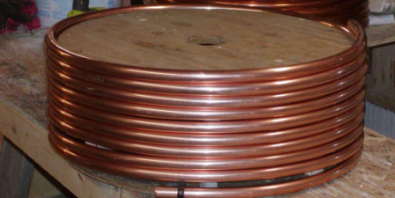
Methods of warming
Passive methods
Active methods
Open chamber
Heat from
above
Heat from below
Closed chamber

Slide 12
Activity
Desert
Match between study system and experimental methods
Confounding variables are unavoidable and influence interpretation of results
Rainforest

Slide 13
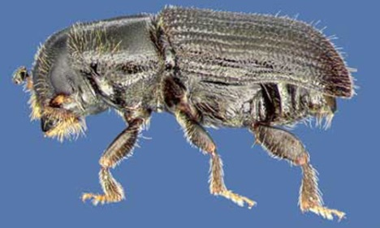
Shifts in geographic ranges: Southern Pine Beetle
B
A
C

Slide 14
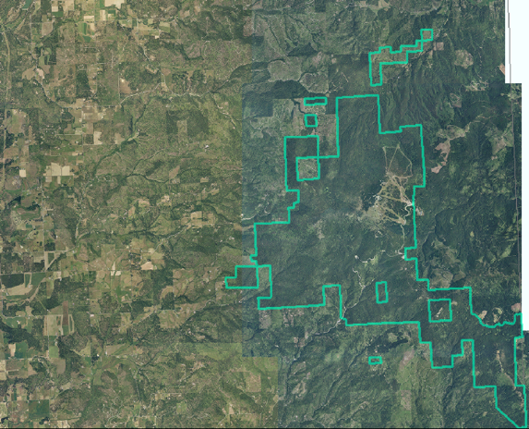
Big question: What management activities will promote/allow for range shifts?
Students pick a specific reserve and develop a management plan
N

Slide 15
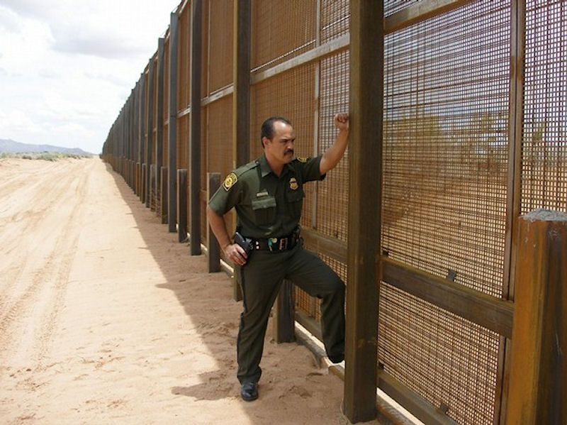
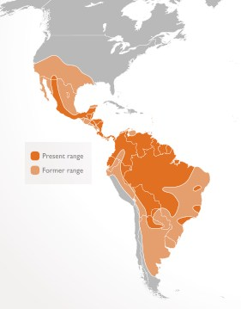
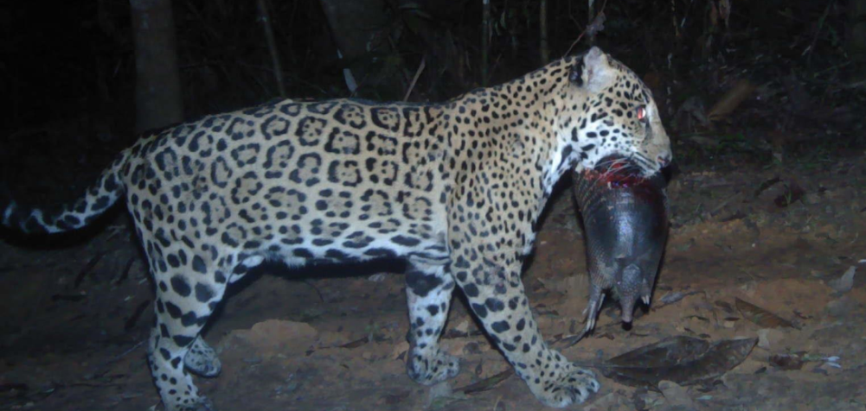
Should we build the southern fence if it restricts range shifts?

Slide 16
Conclusions….
Continue to add active learning activities to improve student learning and engagement

